Slide 1


Winter is Coming, Please Help Detroit
Invest in future Detroit
Hult International Business School – Master of Business Analytics
Communication & Collaboration I: Personal Impact
Team 12 (Scifi 2)
Sreekar Bathula,Yunsik Choung, Jing Li, Tangina Parvez

Slide 2


CONTENTS
Winter is Coming
Who we are?
What we do?
Social Influences of Bill & Melinda Gates Foundation
What do we want to support?
Impact of Future Supporting

Slide 3
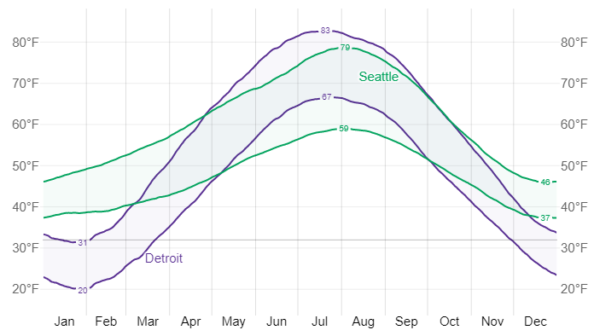
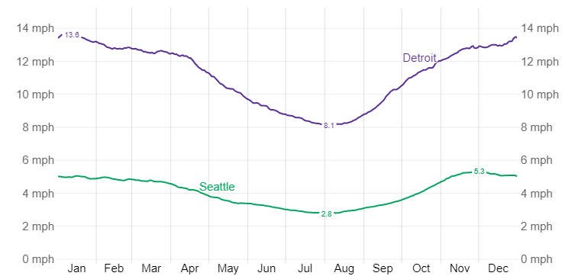
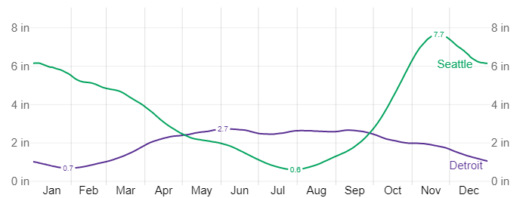
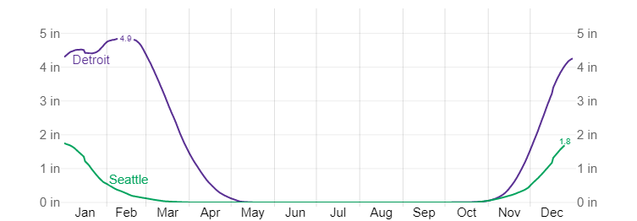
Winter is Coming
Emergency of the homeless problem in Detroit
Temperature in Detroit and Seattle
Wind speed in Detroit and Seattle
Rainfall in Detroit and Seattle
Snowfall in Detroit and Seattle

Slide 4
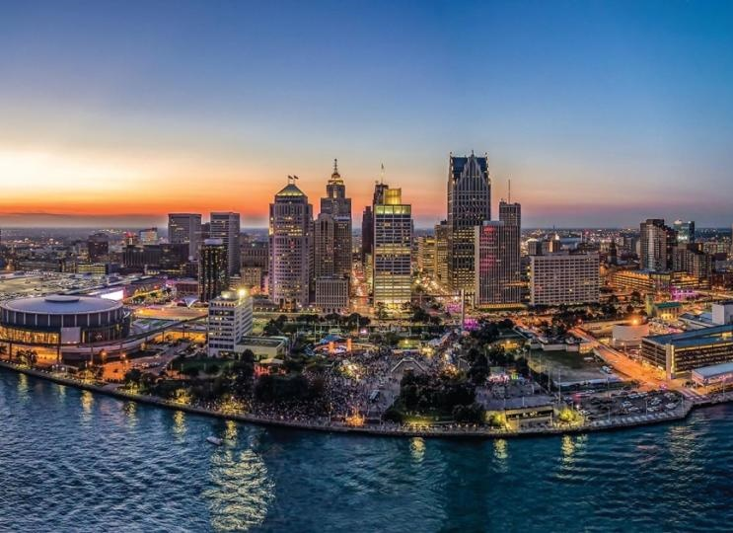
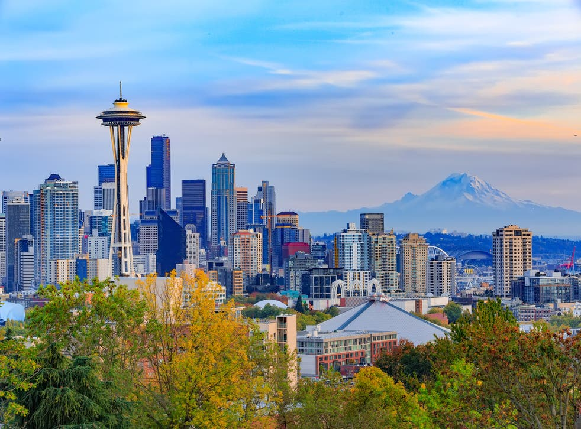
Winter is Coming
Comparison of Detroit with Seattle
Detroit
Seattle
672,351
2020 Population
741,251
-68,900
33.2%
2020 Poverty Rate
10.2%
23.0%p
$32,498
2020 Median Household Income
$97,185
$ -211,846
243,926
(36.3%)
455,772
(61.5%)
2020 Employed Population
-25.2%p

Slide 5
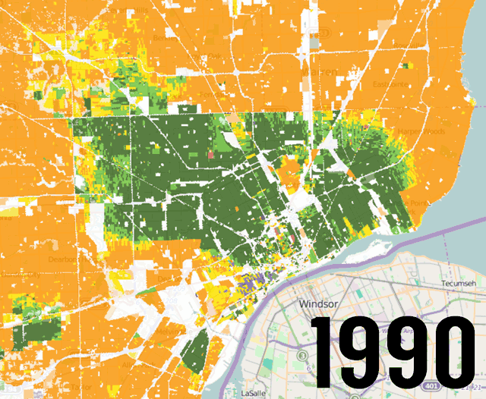
Winter is Coming
What makes Detroit to dark – Social divided of Racial
After the fall of the automobile industries and 1967 Detroit riot, white people left.

Slide 6
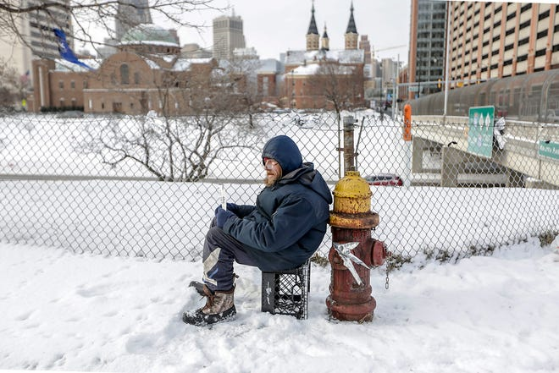
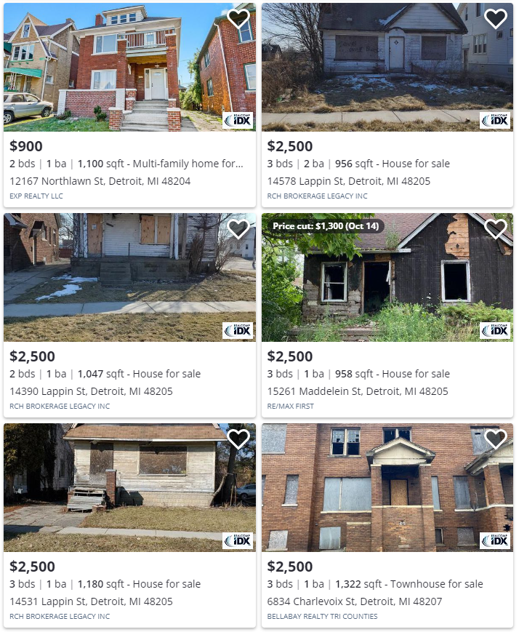
Winter is Coming
Detroit Economy fell, and CBD was in decline with full of abandoned houses.

Slide 7

Who we are?
About TEP
More than 550,000 people experience homelessness on a given night in the United States and roughly 10,000 live in Michigan.
In the world we see, women, children and families living in poverty are no longer victims.
And they are Empowered.

Slide 8




What we do?
About TEP’s activities for Detroit
The Empowerment Plan creates significant economic impact
Our Paid-to-Learn Model
Employees spend an average of two years at Empowerment Plan
Our goal is to help employees secure jobs beyond Empowerment Plan
We provide dedicated paid time for supportive services and programming
100% of employees maintain stable housing one year post graduation

Slide 9
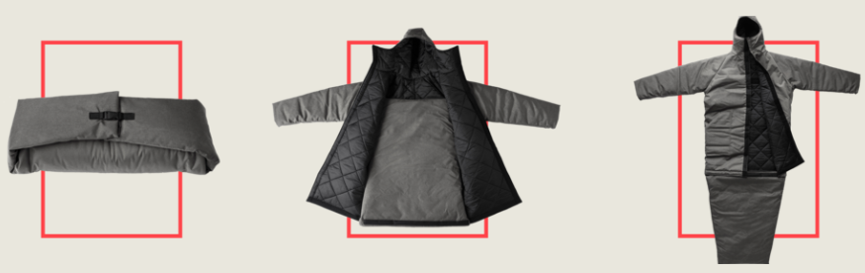
What we do?
The Coat
Our innovative and weather-resistant EMPWR coat
Transform into a sleeping bag
Be worn as an over-the-shoulder bag.
Using upcycled fabric from companies such as GM and Patagonia

Slide 10

Social Influences of Bill & Melinda Gates Foundation
For Earth
Gender Equality
Global Development
Gender Equality Division works to ensure women and girls in Africa and South Asia can enjoy good health, make their own choices, earn their own money, and be leaders in their societies.
Global Development Division focuses on improving the delivery of high-impact health products and services to the world’s poorest communities and helps countries expand access to health coverage.
Global Growth and Opportunity
Global Health
Global Growth & Opportunity Division focuses on creating and scaling market-based innovations to stimulate inclusive and sustainable economic growth.
Global Health Division aims to reduce inequities in health by developing new tools and strategies to reduce the burden of infectious disease and the leading causes of child mortality in developing countries.

Slide 11
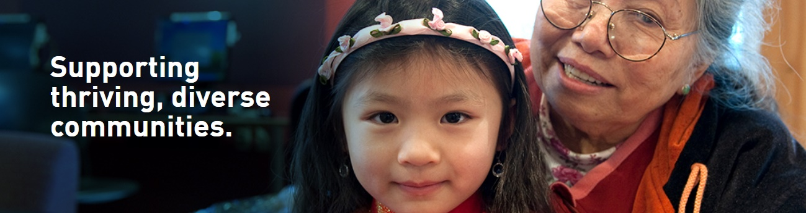
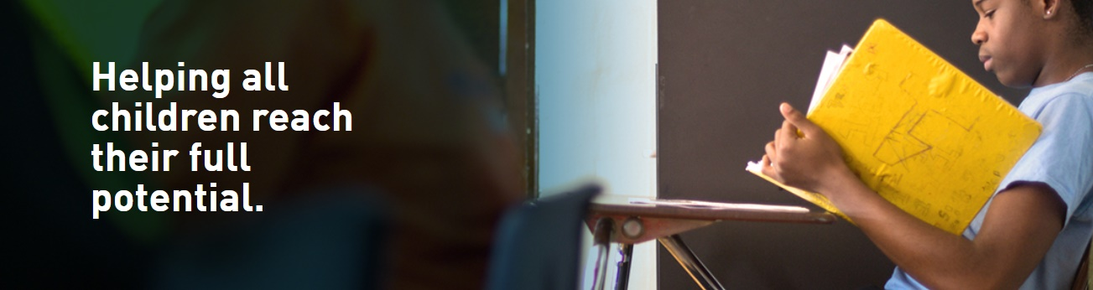
Social Influences of Bill & Melinda Gates Foundation
For Seattle Neighbors
COMMUNITY ENGAGEMENT
EDUCATION
Housing Security and Homelessness
In 2021, we wound down our Family Homelessness strategy after local counties made significant improvements to their crisis response systems.
Launching Partnership for Zero, a new coalition working to dramatically reduce unsheltered homelessness in areas of King County.
We believe that all students in Washington state deserve an education that enables them to achieve their full potential and feel empowered, safe, and supported—regardless of their race, gender, ethnicity, or family income.

Slide 12
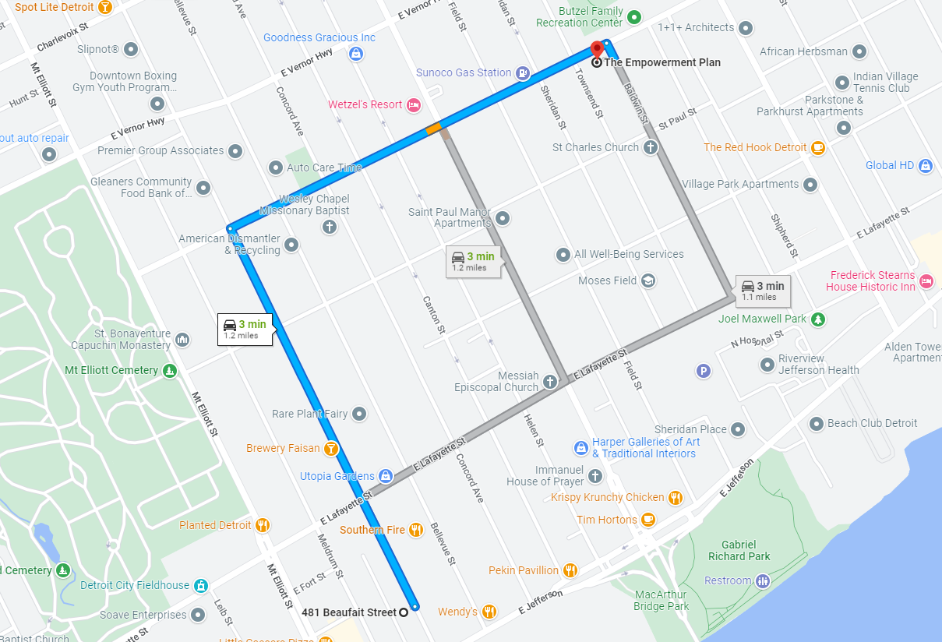
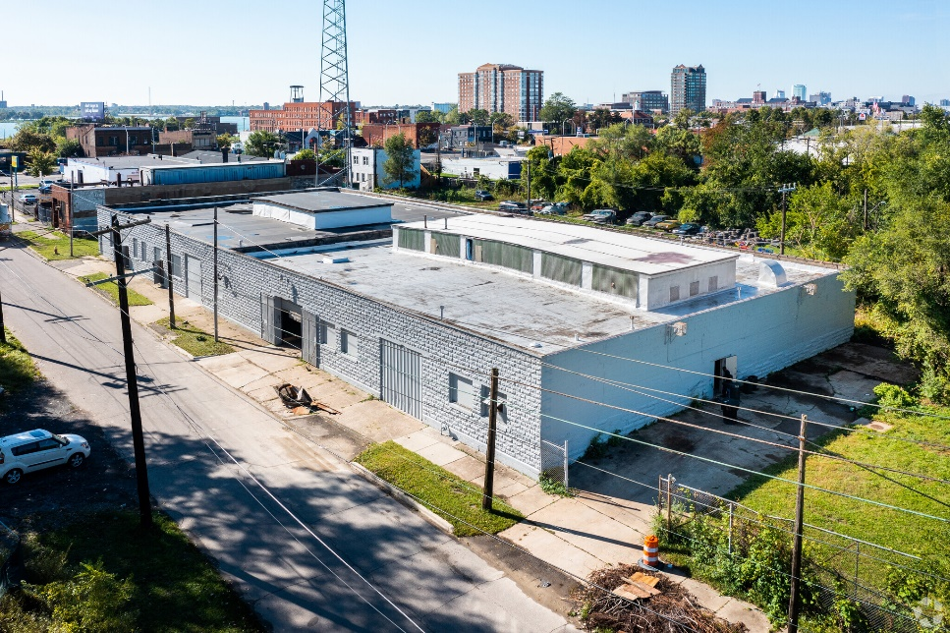
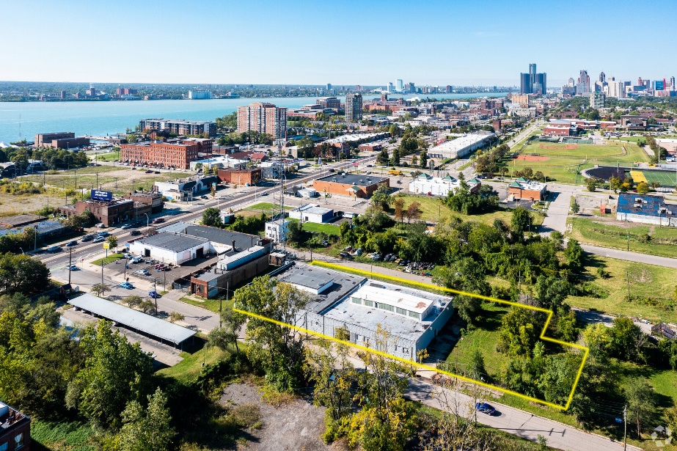
What do we want to support?
Proposal : Build the Gates Empowerment Center - Neighborhood Retraining and Analogue Factory
Buying abandoned Factory for Empowerment
The Empowerment Plan
Gates Empowerment Center

Slide 13
What do we want to support?
Funding: Budget for Build the Gates Empowerment Center
Real Estate Price
Building Renovation Price
Price | $799,000 | Rentable Building Area | 20,400 SF
Price Per SF | $39 | No. Stories | 1
Sale Type | Owner User | Year Built/Renovated | 1921/2019
Sale Conditions | Redevelopment Project | Tenancy | Single
Property Type | Industrial | Clear Ceiling Height | 16 FT
Property Subtype | Warehouse Flex Light Manufacturing Industrial Service Flex Light Distribution | No. Drive In / Grade-Level Doors | 1
Building Class | C | Opportunity Zone | Yes
Lot Size | 1.15 AC
 | Unit Price | Square Foot | Price
Building Renovation Price | $20.00 | 20,400 | $408,000
Total
$1,207,000

Slide 14
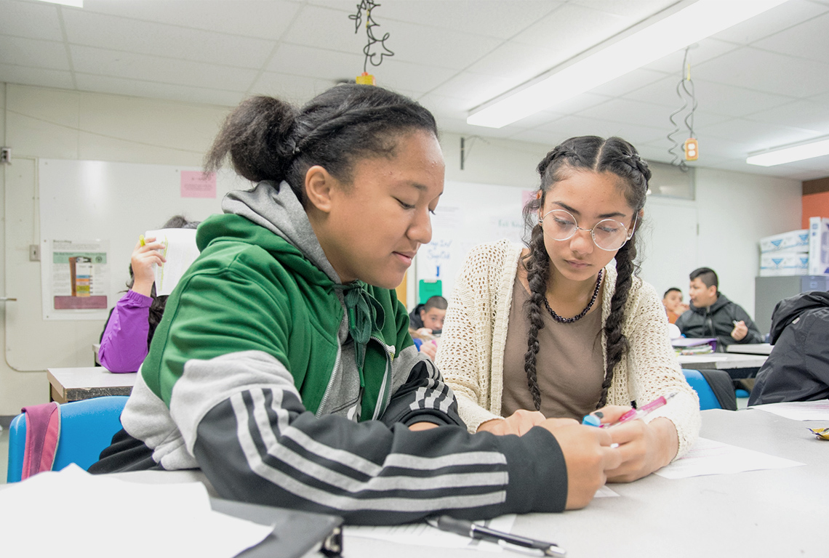
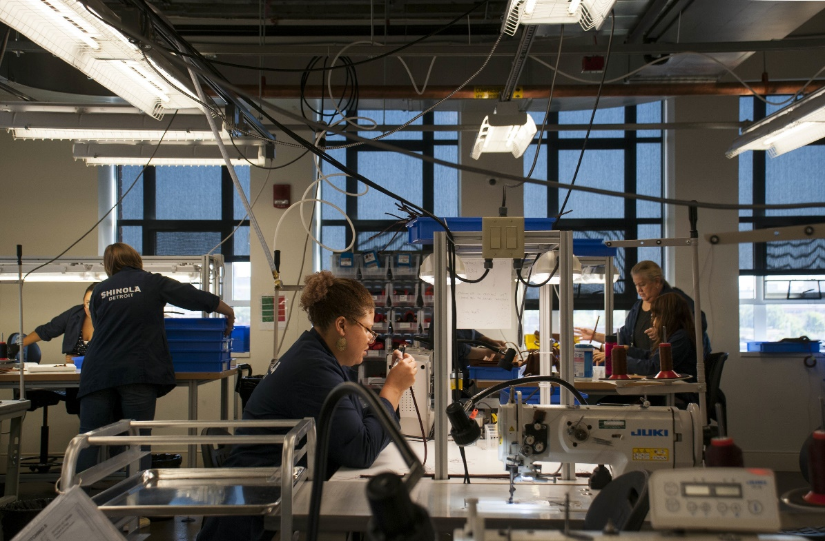
What do we want to support?
Proposal : Build the Gates Empowerment Center - Neighborhood Retraining and Analogue Factory
Tech Education for Children, Skill Training for Unemployeed Neighbors
Please Support Tech Education Programs for Detroit Children
Mathematics, Computer Science and so on.
Skill Training Programs for Unemployed Neighbors
- Leather, Coat, Assemble Watch and so on.

Slide 15


Impact of Future Supporting
Impact for our Neighbors
Fostering Future Innovator
Make Hope to Neighbors
For education equality, we can foster future innovator in Detroit.
Giving equal opportunities to children in poverty, in Detroit.
We can innovate new business with skilled neighbors.
Like Shinola Detroit, We can solve the root cause of POVERTY.

Slide 16
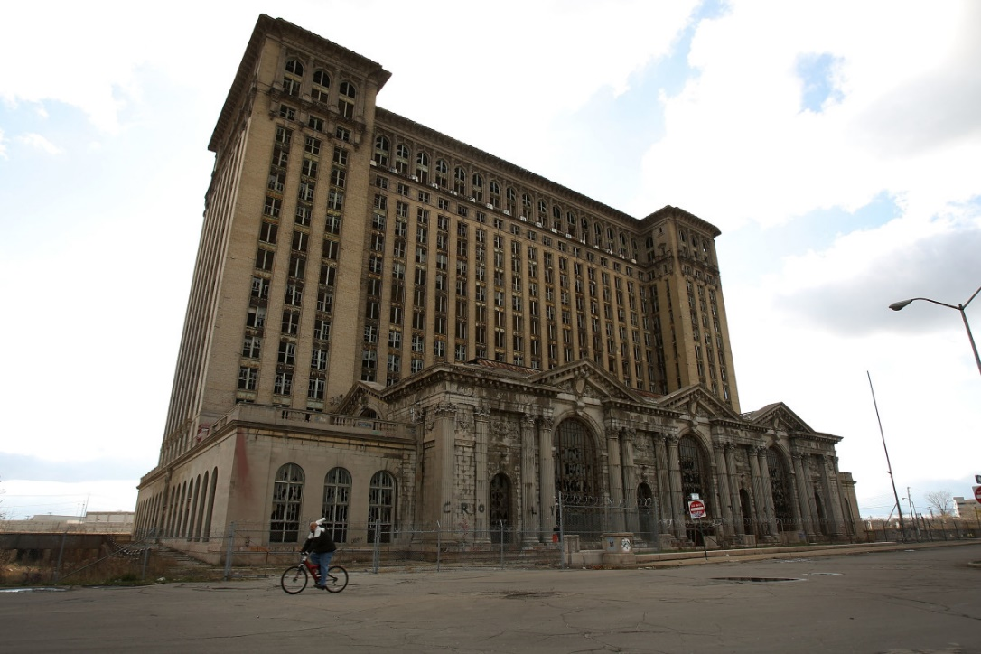
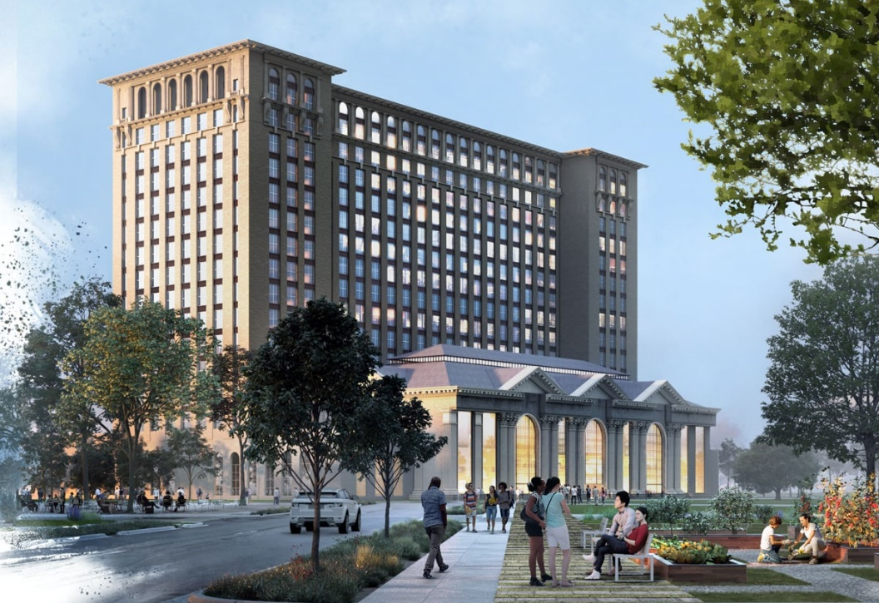




Impact of Future Supporting
Social Impact
Invest to Revitalization Detroit
This is not just for invest to real estate. Invest to future of Detroit
If center will go self-sufficient, we won’t depend on donation.
Michigan Central Project
Jun 19, 2018 – mid 2023

Slide 17
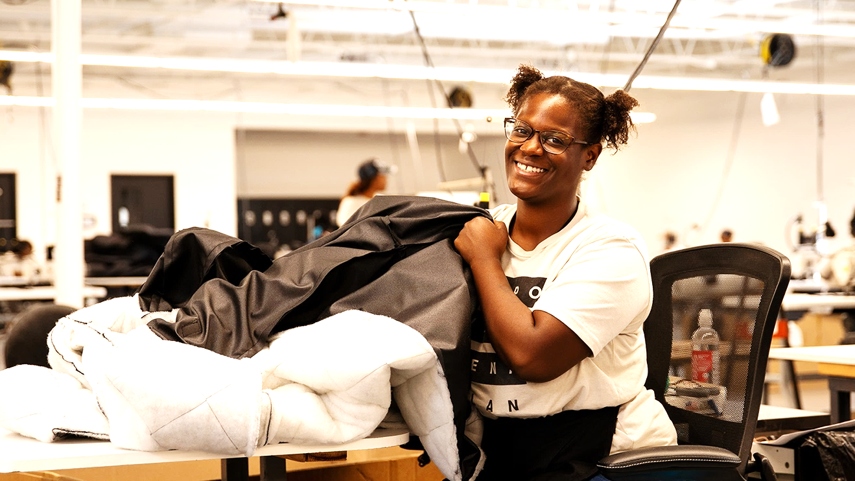
Thank You

